Slide 1

Seven Segment Display (SSD)
By Jatasya Raval

Slide 2
What is SSD?
The numbering system form 0-9 is called as decimal numbering system.
Seven Segment Display is used to display digits from 0 to 9.

Slide 3
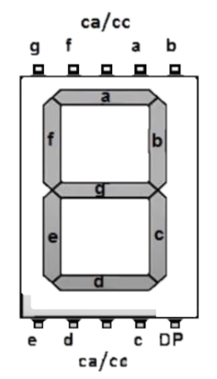
SSD Pin Image

Slide 4
CA/CC (Common cathode/common anode)
So actually, the lines of the SSD are just LEDs and one LED needs two pins to function properly so technically SSD must have 16 pins but there are only 10 so what is done is the CC or the Common Cathode pin is taking all the negative charge for all the LEDs and the other pins of the LEDs should be given a positive charge vice-versa for the CA or the Common Anode. One cc/ca for another four pins on each side.

Slide 5
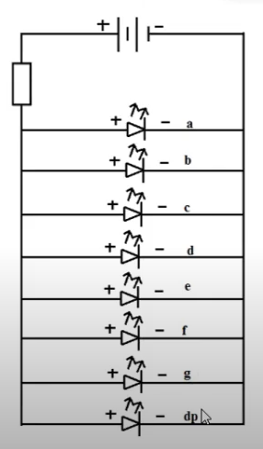
Circuit Symbol of SSD

Slide 6
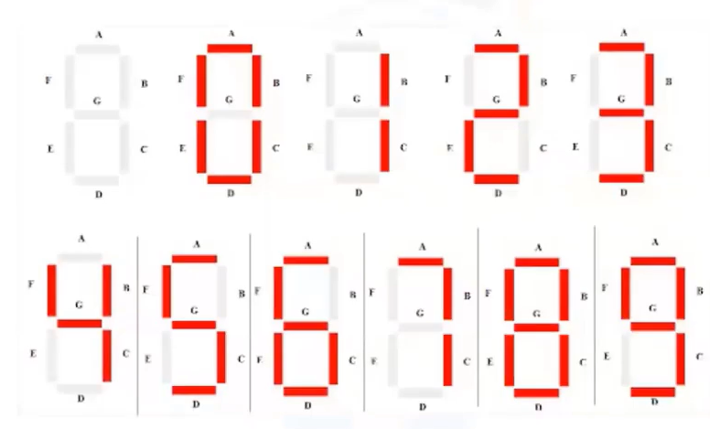
SSD Numbers from 0 to 9

Slide 7
Thank YOu

